Slide 1
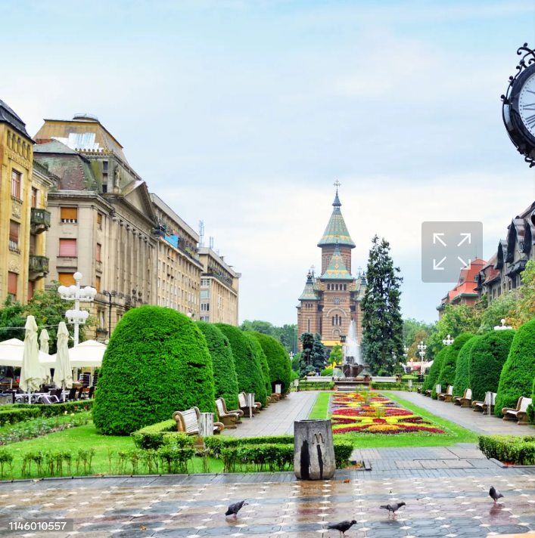
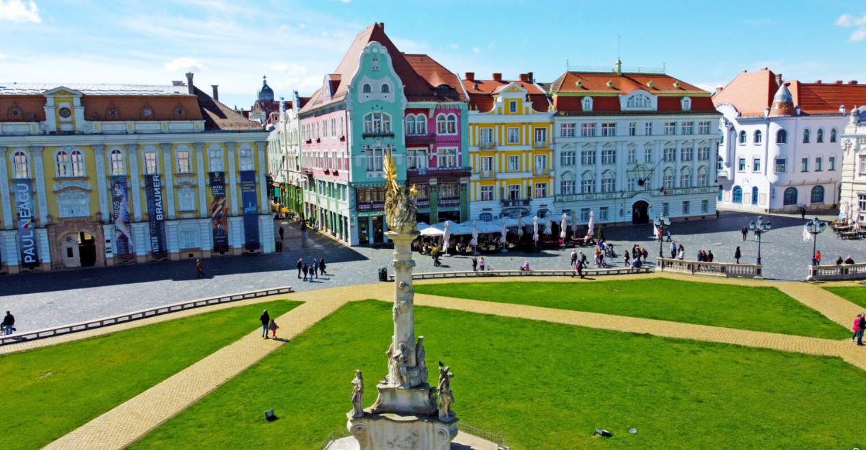
TECHNICAL VISIT ROUTE
for
WORKSHOP IN TIMISOARA:
SUSTAINABLE RURAL AND INTERURBAN ROAD NETWORK
Victoriei Square
Union Square

Slide 2
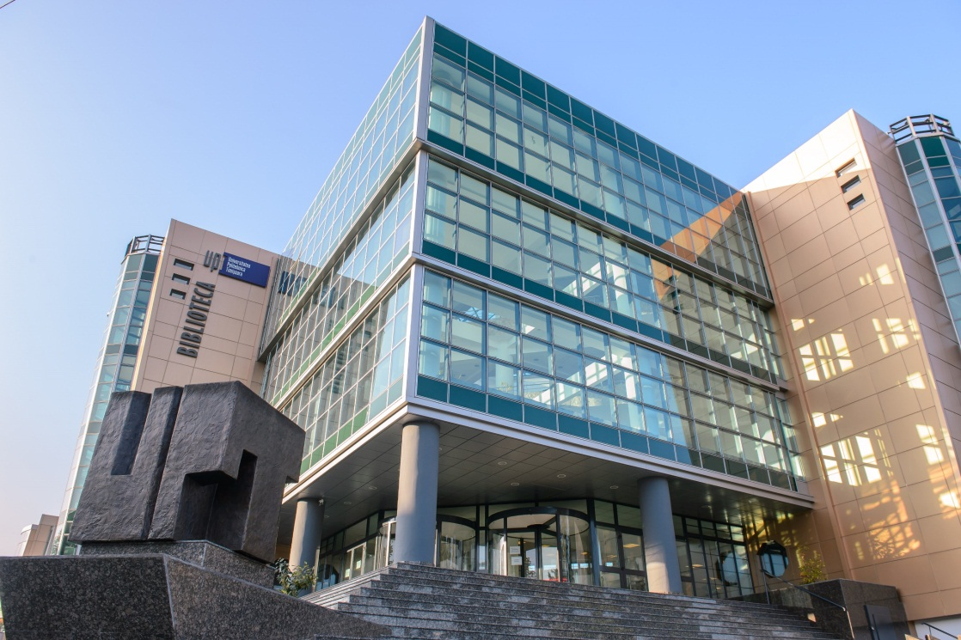
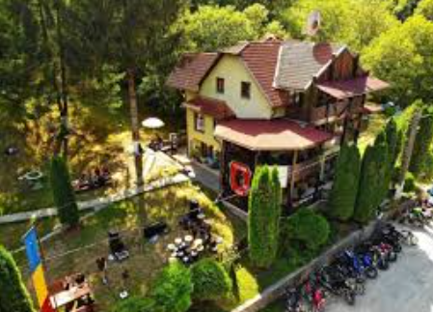
ESTABILISHED ROUTE
Timisoara – Surducu Mic – Zolt – Luncanii de Sus – Luncanii de Jos – Transluncani – Cottage Forestry Cheia
University Politehnica Library – starting point for the technical visit
Cottage Forestry Cheia – ending point for the technical visit

Slide 3
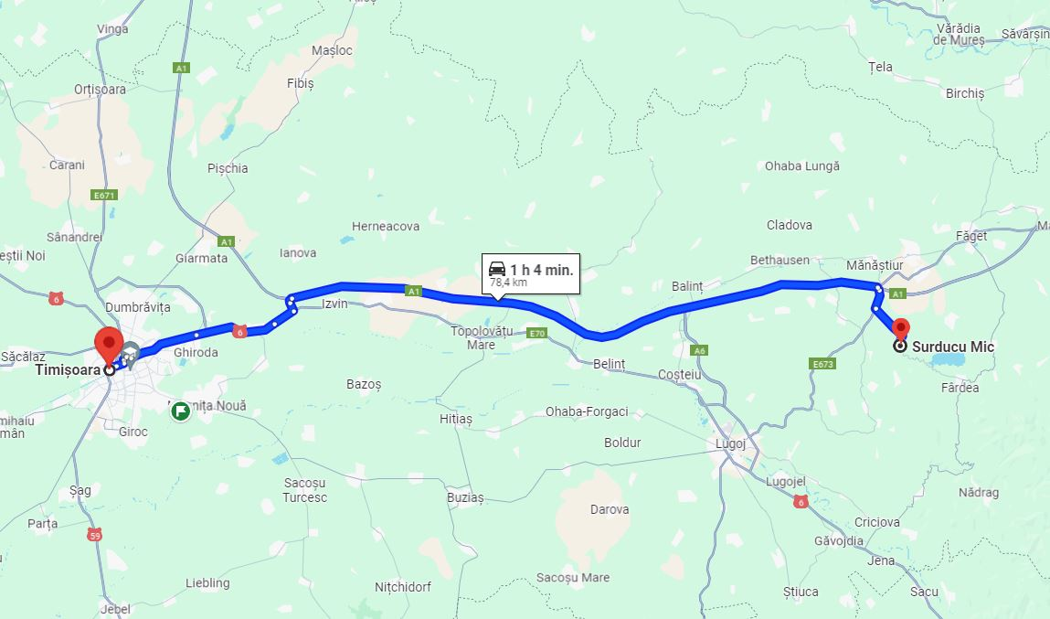
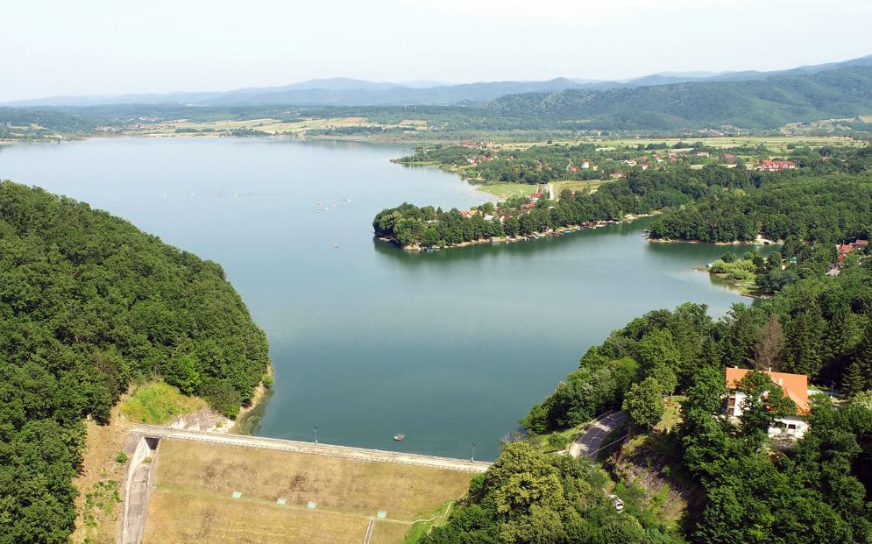
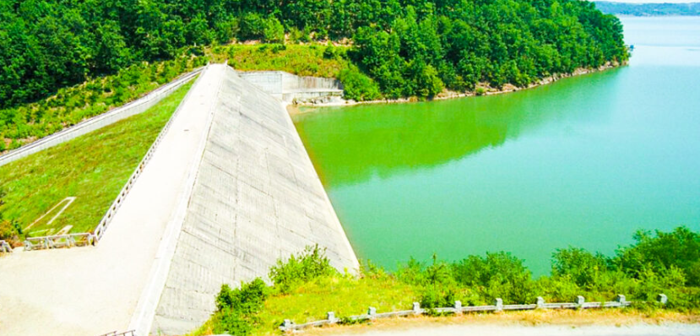
Timisoara – Surducu Mic
Coffe Breack – Surduc dam
Route – Highway A1 and interurban road DJ 681A
Possibility to take pictures

Slide 4
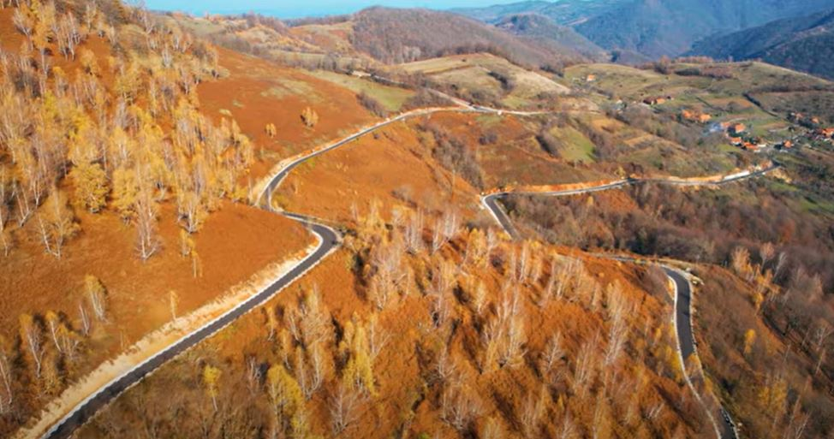
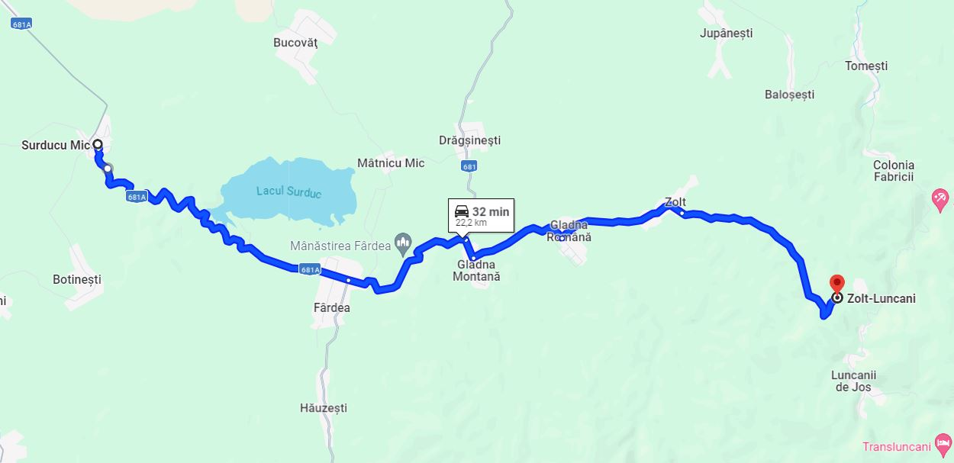
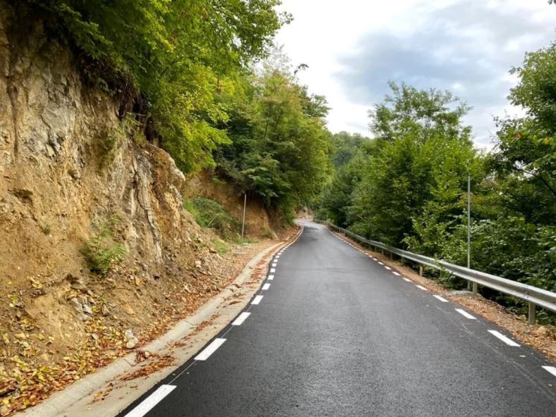
Surducu Mic – Zolt – Luncanii de Sus
Route – interurban roads DJ 681A; DJ 681 and DJ681D and rural road DC 116
Aspects of the rural roads DC 116

Slide 5
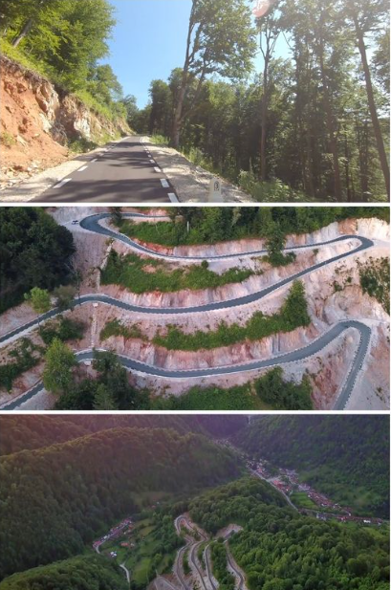
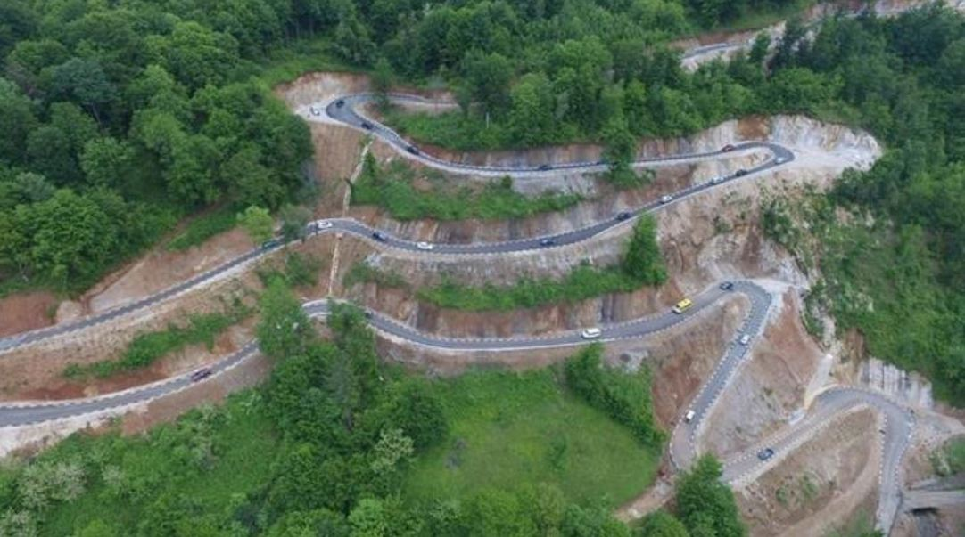
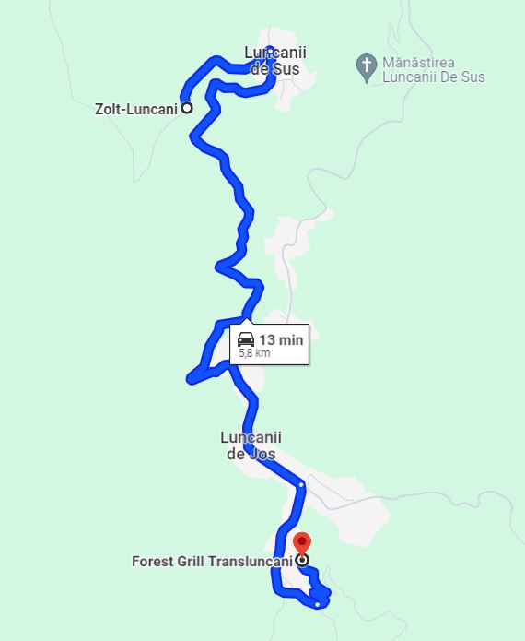
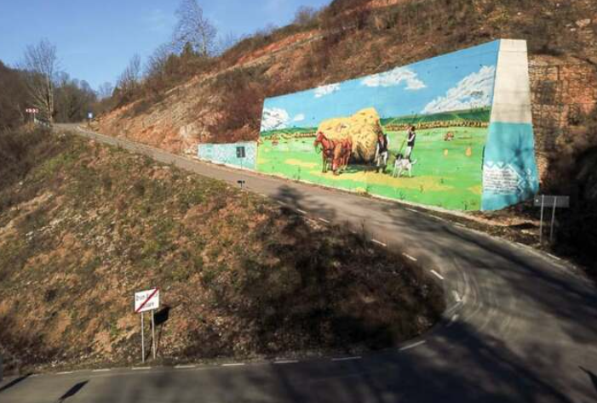
Luncanii de Sus – Luncanii de Jos - Transluncani
Route – rural road DC 116 and agricultural road Oboare (Transluncani)
Aspects of the agricultural road Oboare (Transluncani)

Slide 6
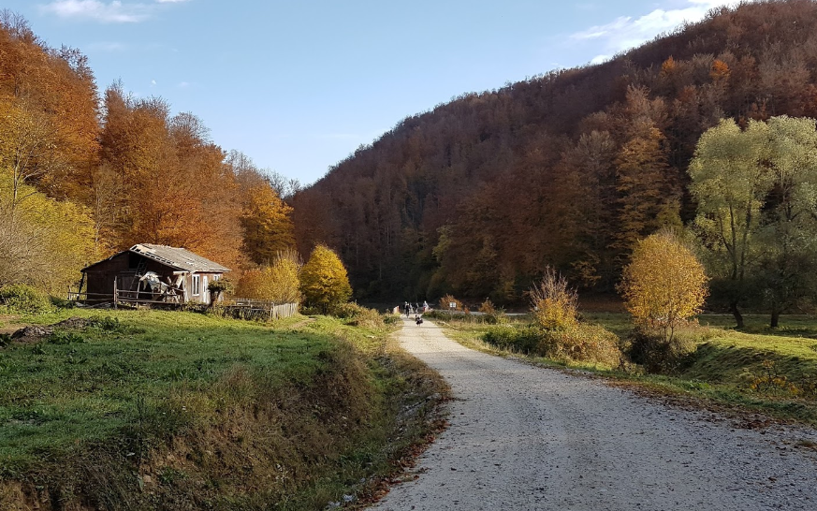
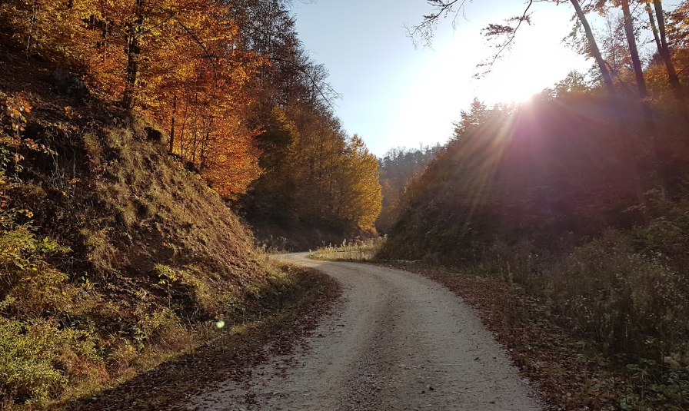
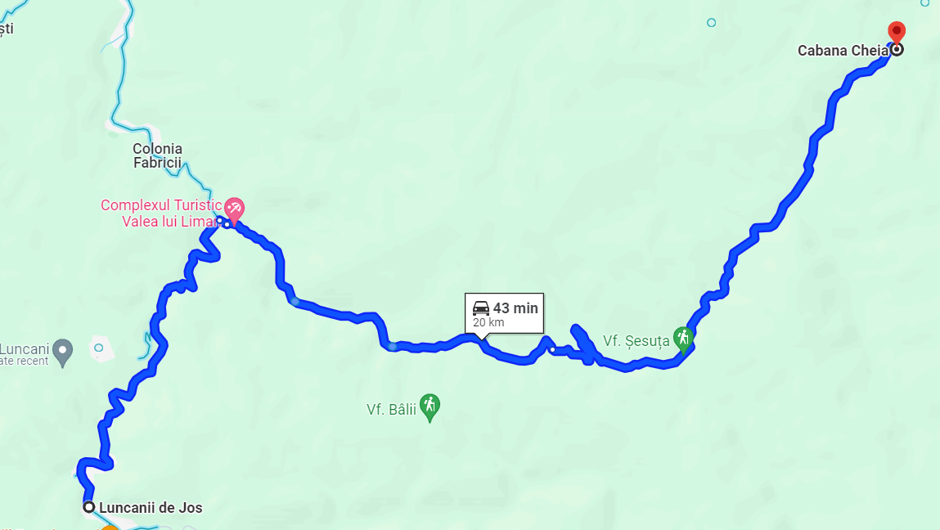
The end point where lunch will be taken
Luncanii de Jos – Cottage Forest Cheia
Aspects of the forestry road Valea lui Liman
Route – agricultural road Oboare (Transluncani) and forestry road Valea lui Liman
The end point where lunch will be taken

Slide 7
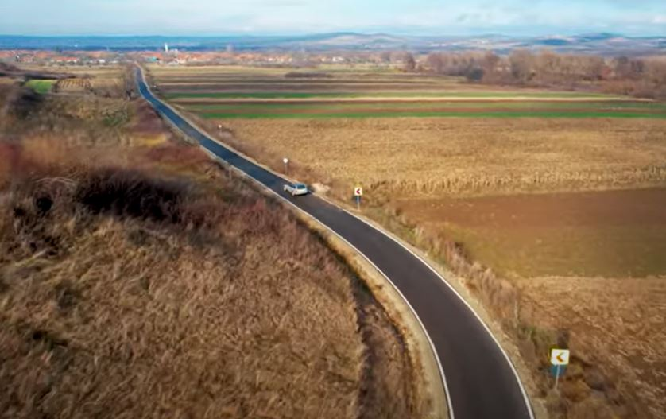
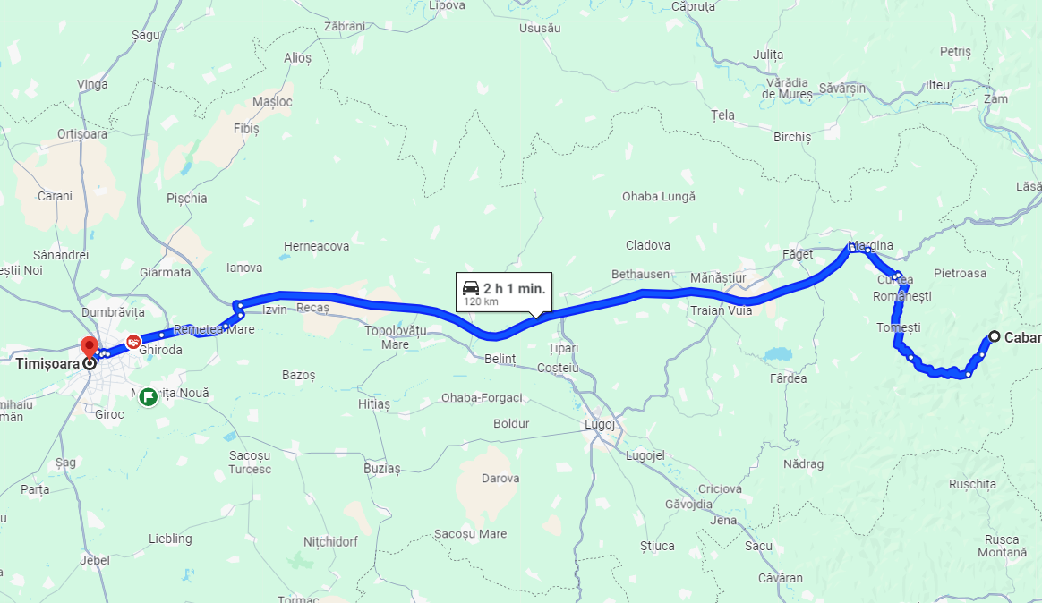
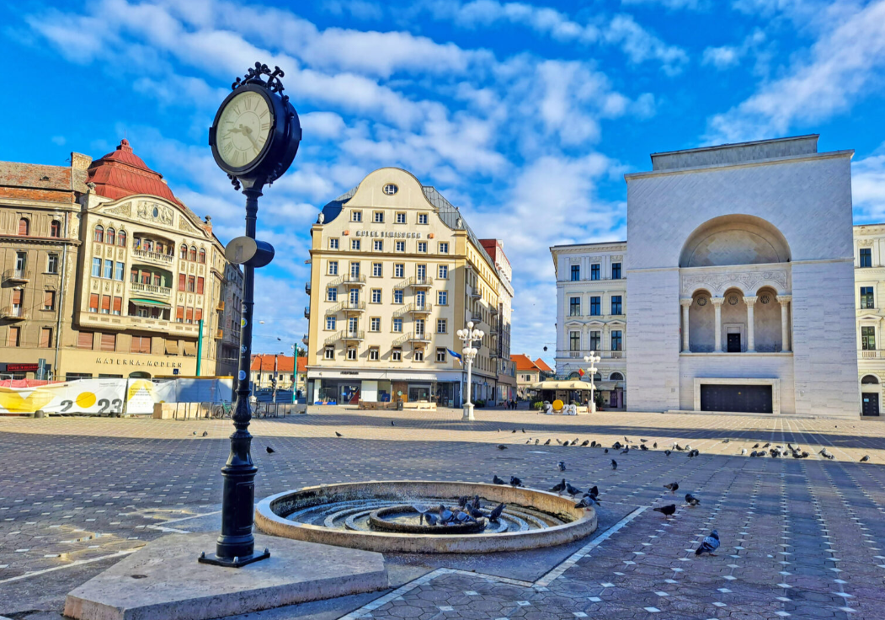
Cottage Forest Cheia - Timisoara
The return route towards Timisoara

Slide 8
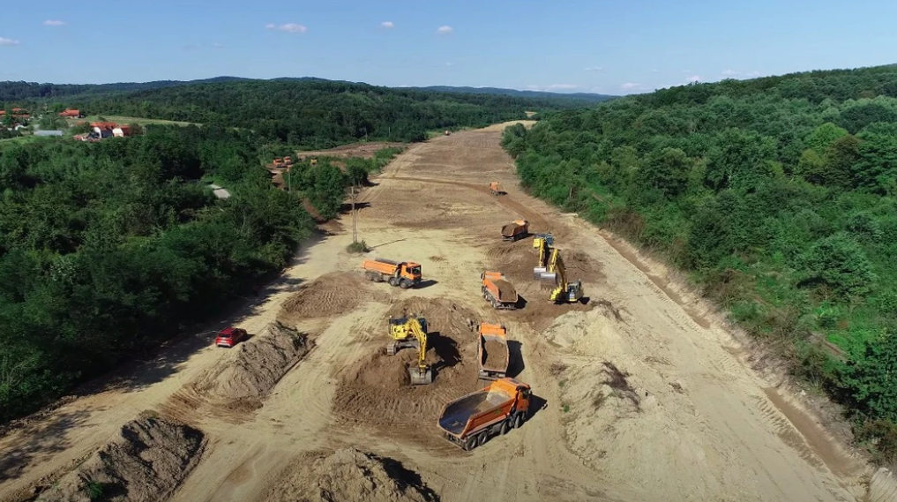
Roads under construction
Depending on the opportunities, we would also like include in the program a visit to a construction site with work in progress
Highway construction nearbay

